Slide 1
Visualization Abstract Theories in DSP Course based on CDIO Concept
Poster Number 133
Wang Li-juan, Li Jian and Zhen Xiao-qiong

Slide 2
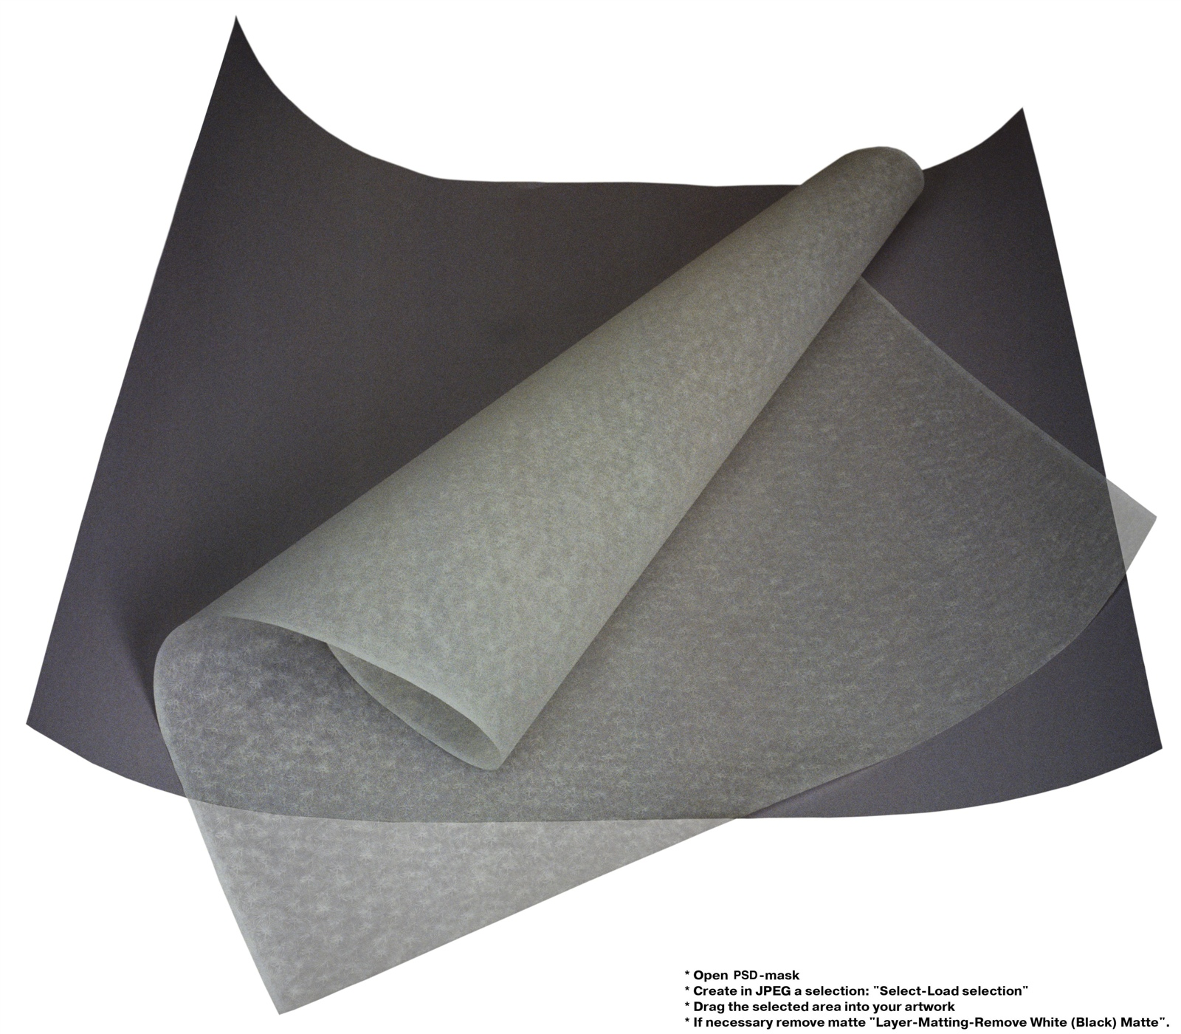

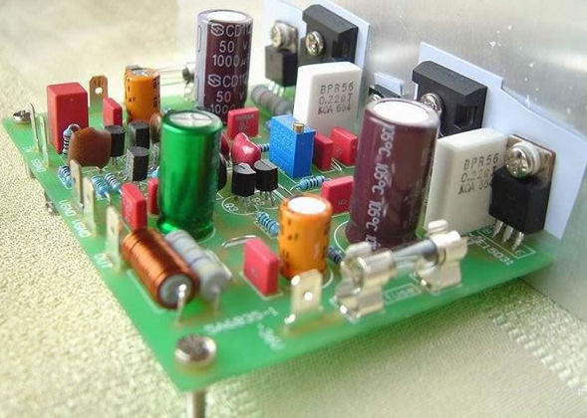

#133
PHOTO
Abastraction
(1).Write down the formula
1
(2).Analyze the physical meaning of the formula
2
Idea of the paper
(3).Conceive a nature thing or phenomenon similar to the physical meaning
3
(4).Find the similarity between the nature thing/phenomenon and formula
4
Visualization

